Slide 1
Assembly Language for Intel-Based Computers, 4th Edition
Kip R. Irvine
Chapter 5: Procedures
Slides prepared by Kip R. Irvine
Revision date: 06/23/02
Chapter corrections (Web) Assembly language sources (Web)
(c) Pearson Education, 2002. All rights reserved. You may modify and copy this slide show for your personal use, or for use in the classroom, as long as this copyright statement, the author's name, and the title are not changed.

Slide 2
Chapter Overview
Linking to an External Library
The Book's Link Library
Stack Operations
Defining and Using Procedures
Program Design Using Procedures

Slide 3
The Book's Link Library
Link Library Overview
Calling a Library Procedure
Linking to a Library
Library Procedures – Overview
Six Examples

Slide 4
Link Library Overview
A file containing procedures that have been compiled into machine code
  constructed from one or more OBJ files
To build a library, . . .
  start with one or more ASM source files
  assemble each into an OBJ file
  create an empty library file (extension .LIB)
  add the OBJ file(s) to the library file, using the Microsoft LIB utility
Take a quick look at Irvine32.asm by clicking on Examples at the bottom of this screen.

Slide 5
Calling a Library Procedure
Call a library procedure using the CALL instruction. Some procedures require input arguments. The INCLUDE directive copies in the procedure prototypes (declarations).
The following example displays "1234" on the console:
INCLUDE Irvine32.inc
.code
mov eax,1234h ; input argument
call WriteHex ; show hex number
call Crlf ; end of line

Slide 6
Linking to a Library
Your programs link to Irvine32.lib using the linker command inside a batch file named make32.bat.
Notice the two LIB files: Irvine32.lib, and kernel32.lib
  the latter is part of the Microsoft Win32 Software Devlopment Kit

Slide 7
Library Procedures - Overview (1 of 3)
Clrscr - Clears the console and locates the cursor at the upper left corner.
Crlf - Writes an end of line sequence to standard output.
Delay - Pauses the program execution for a specified n millisecond interval.
DumpMem - Writes a block of memory to standard output in hexadecimal.
DumpRegs - Displays the EAX, EBX, ECX, EDX, ESI, EDI, EBP, ESP, EFLAGS, and EIP registers in hexadecimal. Also displays the Carry, Sign, Zero, and Overflow flags.
GetCommandtail - Copies the program’s command-line arguments (called the command tail) into an array of bytes.
GetMseconds - Returns the number of milliseconds that have elapsed since midnight.

Slide 8
Library Procedures - Overview (2 of 3)
Gotoxy - Locates cursor at row and column on the console.
Random32 - Generates a 32-bit pseudorandom integer in the range 0 to FFFFFFFFh.
Randomize - Seeds the random number generator.
RandomRange - Generates a pseudorandom integer within a specified range.
ReadChar - Reads a single character from standard input.
ReadHex - Reads a 32-bit hexadecimal integer from standard input, terminated by the Enter key.
ReadInt - Reads a 32-bit signed decimal integer from standard input, terminated by the Enter key.
ReadString - Reads a string from standard input, terminated by the Enter key.

Slide 9
Library Procedures - Overview (3 of 3)
SetTextColor - Sets the foreground and background colors of all subsequent text output to the console.
WaitMsg - Displays message, waits for Enter key to be pressed.
WriteBin - Writes an unsigned 32-bit integer to standard output in ASCII binary format.
WriteChar - Writes a single character to standard output.
WriteDec - Writes an unsigned 32-bit integer to standard output in decimal format.
WriteHex - Writes an unsigned 32-bit integer to standard output in hexadecimal format.
WriteInt - Writes a signed 32-bit integer to standard output in decimal format.
WriteString - Writes a null-terminated string to standard output.

Slide 10
Example 1
Clear the screen, delay the program for 500 milliseconds, and dump the registers and flags.
.code
call Clrscr
mov eax,500
call Delay
call DumpRegs
Sample output:
EAX=00000613 EBX=00000000 ECX=000000FF EDX=00000000
ESI=00000000 EDI=00000100 EBP=0000091E ESP=000000F6
EIP=00401026 EFL=00000286 CF=0 SF=1 ZF=0 OF=0

Slide 11
Example 2
Display a null-terminated string and move the cursor to the beginning of the next screen line.
.data
str1 BYTE "Assembly language is easy!",0
.code
mov edx,OFFSET str1
call WriteString
call Crlf

Slide 12
Example 3
Display the same unsigned integer in binary, decimal, and hexadecimal. Each number is displayed on a separate line.
IntVal = 35 ; constant
.code
mov eax,IntVal
call WriteBin ; display binary
call Crlf
call WriteDec ; display decimal
call Crlf
call WriteHex ; display hexadecimal
call Crlf
Sample output:
0000 0000 0000 0000 0000 0000 0010 0011
35
23

Slide 13
Example 4
Input a string from the user. EDX points to the string and ECX specifies the maximum number of characters the user is permitted to enter.
.data
fileName BYTE 80 DUP(0)
.code
mov edx,OFFSET fileName
mov ecx,SIZEOF fileName – 1
call ReadString

Slide 14
Example 5
Generate and display ten pseudorandom signed integers in the range 0 – 99. Each integer is passed to WriteInt in EAX and displayed on a separate line.
.code
mov ecx,10 ; loop counter
L1: mov eax,100 ; ceiling value
call RandomRange ; generate random int
call WriteInt ; display signed int
call Crlf ; goto next display line
loop L1 ; repeat loop

Slide 15
Example 6
Display a null-terminated string with yellow characters on a blue background.
.data
str1 BYTE "Color output is easy!",0
.code
mov eax,yellow + (blue * 16)
call SetTextColor
mov edx,OFFSET str1
call WriteString
call Crlf
The background color must be multiplied by 16 before you add it to the foreground color.

Slide 16
Stack Operations
Runtime Stack
PUSH Operation
POP Operation
PUSH and POP Instructions
Using PUSH and POP
Example: Reversing a String
Related Instructions

Slide 17
Runtime Stack
Managed by the CPU, using two registers
  SS (stack segment)
  ESP (stack pointer) *
* SP in Real-address mode

Slide 18
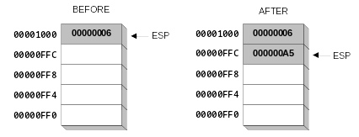
PUSH Operation (1 of 2)
A 32-bit push operation decrements the stack pointer by 4 and copies a value into the location pointed to by the stack pointer.

Slide 19
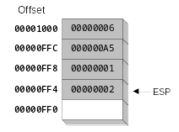
PUSH Operation (2 of 2)
This is the same stack, after pushing two more integers:
The stack grows downward. The area below ESP is always available (unless the stack has overflowed).

Slide 20
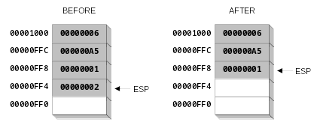
POP Operation
Copies value at stack[ESP] into a register or variable.
Adds n to ESP, where n is either 2 or 4.
  depends on the attribute of the operand receiving the data

Slide 21
PUSH and POP Instructions
PUSH syntax:
  PUSH r/m16
  PUSH r/m32
  PUSH imm32
POP syntax:
  POP r/m16
  POP r/m32

Slide 22
Using PUSH and POP
Save and restore registers when they contain important values. Note that the PUSH and POP instructions are in the opposite order:
push esi ; push registers
push ecx
push ebx
mov esi,OFFSET dwordVal ; starting OFFSET
mov ecx,LENGTHOF dwordVal ; number of units
mov ebx,TYPE dwordVal ; size of a doubleword
call DumpMem ; display memory
pop ebx ; opposite order
pop ecx
pop esi

Slide 23
Example: Reversing a String
Use a loop with indexed addressing
Push each character on the stack
Start at the beginning of the string, pop the stack in reverse order, insert each character into the string
Source code
Q: Why must each character be put in EAX before it is pushed?
Because only word (16-bit) or doubleword (32-bit) values can be pushed on the stack.

Slide 24
Your turn . . .
Using the String Reverse program as a starting point,
#1: Modify the program so the user can input a string of up to 50 characters.
#2: Modify the program so it inputs a list of 32-bit integers from the user, and then displays the integers in reverse order.

Slide 25
Related Instructions
PUSHFD and POPFD
  push and pop the EFLAGS register
PUSHAD pushes the 32-bit general-purpose registers on the stack
  order: EAX, ECX, EDX, EBX, ESP, EBP, ESI, EDI
POPAD pops the same registers off the stack in reverse order
  PUSHA and POPA do the same for 16-bit registers

Slide 26
Your Turn . . .
Write a program that does the following:
  Assigns integer values to EAX, EBX, ECX, EDX, ESI, and EDI
  Uses PUSHAD to push the general-purpose registers on the stack
  Using a loop, the program pops each integer from the stack and displays it on the screen

Slide 27
Defining and Using Procedures
Creating Procedures
Documenting Procedures
Example: SumOf Procedure
CALL and RET Instructions
Nested Procedure Calls
Local and Global Labels
Procedure Parameters
Flowchart Symbols
USES Operator

Slide 28
Creating Procedures
Large problems can be divided into smaller tasks to make them more manageable
A procedure is the ASM equivalent of a Java or C++ function
Following is an assembly language procedure named sample:
sample PROC
  .
  .
  ret
sample ENDP

Slide 29
Documenting Procedures
Suggested documentation for each procedure:
A description of all tasks accomplished by the procedure.
Receives: A list of input parameters; state their usage and requirements.
Returns: A description of values returned by the procedure.
Requires: Optional list of requirements called preconditions that must be satisfied before the procedure is called.
If a procedure is called without its preconditions having been satisfied, the procedure's creator makes no promise that it will work.

Slide 30
Example: SumOf Procedure
;---------------------------------------------------------
SumOf PROC
;
; Calculates and returns the sum of three 32-bit integers.
; Receives: EAX, EBX, ECX, the three integers. May be
; signed or unsigned.
; Returns: EAX = sum, and the status flags (Carry,
; Overflow, etc.) are changed.
; Requires: nothing
;---------------------------------------------------------
  add eax,ebx
  add eax,ecx
  ret
SumOf ENDP

Slide 31
CALL and RET Instructions
The CALL instruction calls a procedure
  pushes offset of next instruction on the stack
  copies the address of the called procedure into EIP
The RET instruction returns from a procedure
  pops top of stack into EIP

Slide 32
CALL-RET Example (1 of 2)
main PROC
  00000020 call MySub
  00000025 mov eax,ebx
  .
  .
main ENDP
MySub PROC
  00000040 mov eax,edx
  .
  .
  ret
MySub ENDP
0000025 is the offset of the instruction immediately following the CALL instruction
00000040 is the offset of the first instruction inside MySub

Slide 33

CALL-RET Example (2 of 2)
The CALL instruction pushes 00000025 onto the stack, and loads 00000040 into EIP
The RET instruction pops 00000025 from the stack into EIP

Slide 34
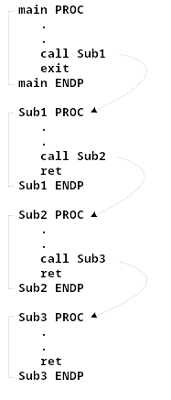
Nested Procedure Calls
By the time Sub3 is called, the stack contains all three return addresses:

Slide 35
Local and Global Labels
A local label is visible only to statements inside the same procedure. A global label is visible everywhere.
main PROC
jmp L2 ; error!
L1:: ; global label
exit
main ENDP
sub2 PROC
L2: ; local label
jmp L1 ; ok
ret
sub2 ENDP

Slide 36
Procedure Parameters (1 of 3)
A good procedure might be usable in many different programs
  but not if it refers to specific variable names
Parameters help to make procedures flexible because parameter values can change at runtime

Slide 37
Procedure Parameters (2 of 3)
The ArraySum procedure calculates the sum of an array. It makes two references to specific variable names:
ArraySum PROC
  mov esi,0 ; array index
  mov eax,0 ; set the sum to zero
L1: add eax,myArray[esi] ; add each integer to sum
  add esi,4 ; point to next integer
  loop L1 ; repeat for array size
  mov theSum,eax ; store the sum
ret
ArraySum ENDP
What if you wanted to calculate the sum of two or three arrays within the same program?

Slide 38
Procedure Parameters (3 of 3)
This version of ArraySum returns the sum of any doubleword array whose address is in ESI. The sum is returned in EAX:
ArraySum PROC
; Recevies: ESI points to an array of doublewords,
; ECX = number of array elements.
; Returns: EAX = sum
;-----------------------------------------------------
  mov eax,0 ; set the sum to zero
L1: add eax,[esi] ; add each integer to sum
  add esi,4 ; point to next integer
  loop L1 ; repeat for array size
ret
ArraySum ENDP

Slide 39
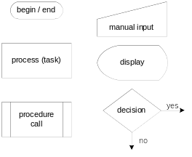
Flowchart Symbols
The following symbols are the basic building blocks of flowcharts:
(Includes two symbols not listed on page 166 of the book.)

Slide 40
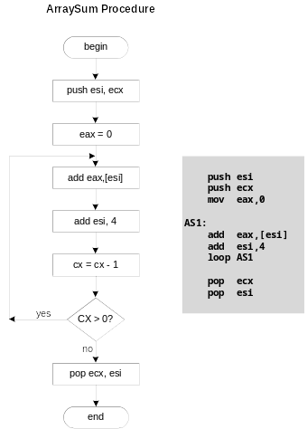
Flowchart for the ArraySum Procedure

Slide 41
Your turn . . .
Draw a flowchart that expresses the following pseudocode:
  input exam grade from the user
  if( grade > 70 )
  display "Pass"
  else
  display "Fail"
  endif

Slide 42
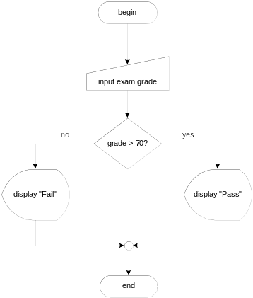
. . . (Solution)

Slide 43
Your turn . . .
Modify the flowchart in the previous slide to allow the user to continue to input exam scores until a value of –1 is entered

Slide 44
USES Operator
Lists the registers that will be saved
ArraySum PROC USES esi ecx
mov eax,0 ; set the sum to zero
etc.
MASM generates the following code:
ArraySum PROC
push esi
push ecx
.
.
pop ecx
pop esi
ret
ArraySum ENDP

Slide 45
When not to push a register
The sum of the three registers is stored in EAX on line (3), but the POP instruction replaces it with the starting value of EAX on line (4):
SumOf PROC ; sum of three integers
  push eax ; 1
  add eax,ebx ; 2
  add eax,ecx ; 3
  pop eax ; 4
  ret
SumOf ENDP

Slide 46
Program Design Using Procedures
Top-Down Design (functional decomposition) involves the following:
  design your program before starting to code
  break large tasks into smaller ones
  use a hierarchical structure based on procedure calls
  test individual procedures separately

Slide 47
Integer Summation Program (1 of 4)
Description: Write a program that prompts the user for multiple 32-bit integers, stores them in an array, calculates the sum of the array, and displays the sum on the screen.
Main steps:
Prompt user for multiple integers
Calculate the sum of the array
Display the sum

Slide 48
Procedure Design (2 of 4)
Main
Clrscr ; clear screen
PromptForIntegers
WriteString ; display string
ReadInt ; input integer
ArraySum ; sum the integers
DisplaySum
WriteString ; display string
WriteInt ; display integer

Slide 49
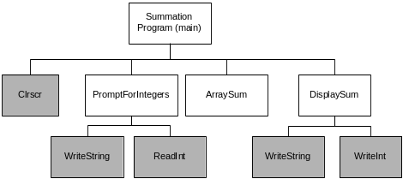
Structure Chart (3 of 4)
gray indicates library procedure
View the stub program
View the final program

Slide 50
Sample Output (4 of 4)
Enter a signed integer: 550
Enter a signed integer: -23
Enter a signed integer: -96
The sum of the integers is: +431

Slide 51

The End

